Slide 1
PHYS60022 Data Science and Machine Learning for Physics
Week 4: Discussion
Spring 2025

Slide 2
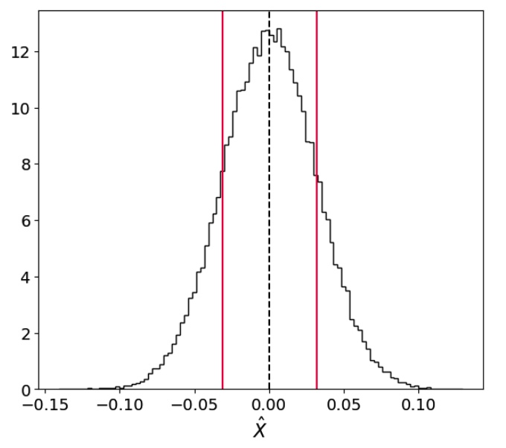
Uncertainties
In the lectures so far, we have been rather vague about what we mean by an uncertainty in a measurement
One very practical definition is the standard deviation of an estimator
Measurement of X,
^
X
σ
^
X
This is not however what statisticians mean

Slide 3
Uncertainties
We have to return to our rivals, the Frequentists and the Bayesians,
Frequentist : A confidence interval is an interval in the parameter θ that contains the true value θ₀ a certain fraction of the time (1-α). The measured value is usually the estimate (often MLE) θ.
Bayesian : A credible interval is an interval in θ that contains a certain fraction (1-α) of the posterior probability density p(θ|X). The measured value is the most probable value (or max posterior value).
If α = 0.05, we say these are 95% confidence/credible intervals
If α = 0.32, we say these are 68% confidence/credible intervals
…
Both definitions are valid within their own paradigm, both can be extended to multiple parameters (confidence and credible regions).
^

Slide 4
Confidence intervals
Confidence intervals are very much related to the idea of hypothesis testing.
Suppose we want to test the hypothesis that the parameter θ has a true value θ₀
→ The null hypothesis H₀ → H(θ₀)
Let’s choose as the alternate hypothesis (H₁) the value of the parameter for a given dataset that maximises the likelihood (remember, this is like choosing our best guess for the parameter value) θ
→ The alternate hypothesis H₁ → H(θ)
We cannot use the Neyman-Pearson lemma here, but it is true (I won’t prove why) that on average, the best test-statistic to use is,
^
^
Note that this value is always positive!
The critical region should be chosen as large values of this quantity

Slide 5
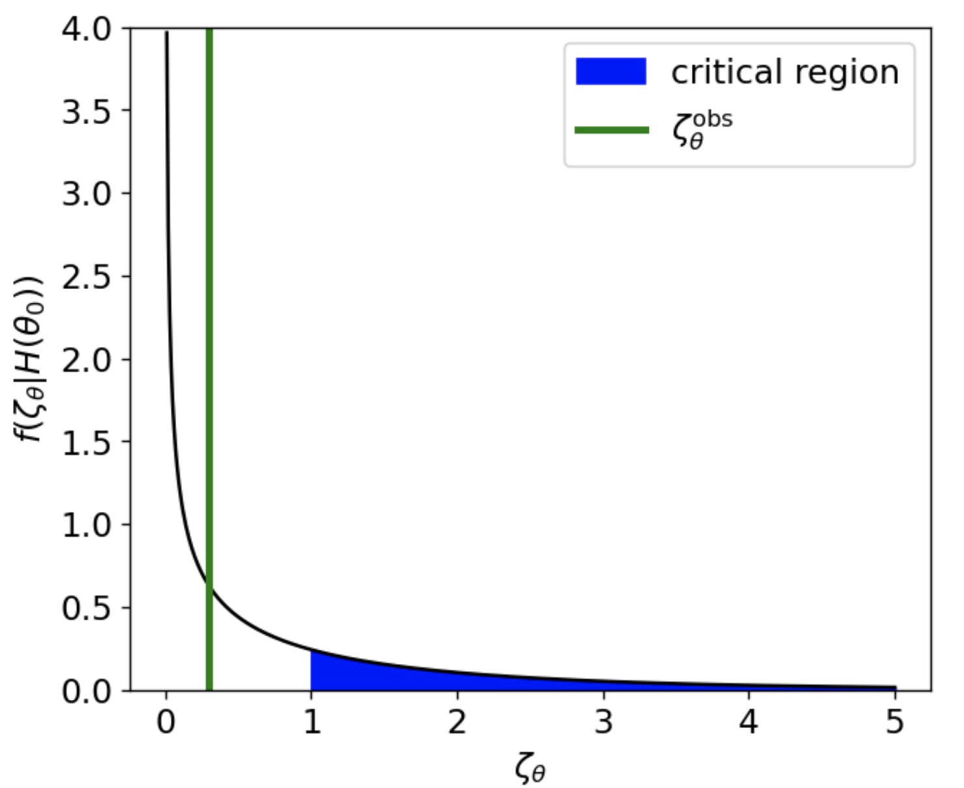
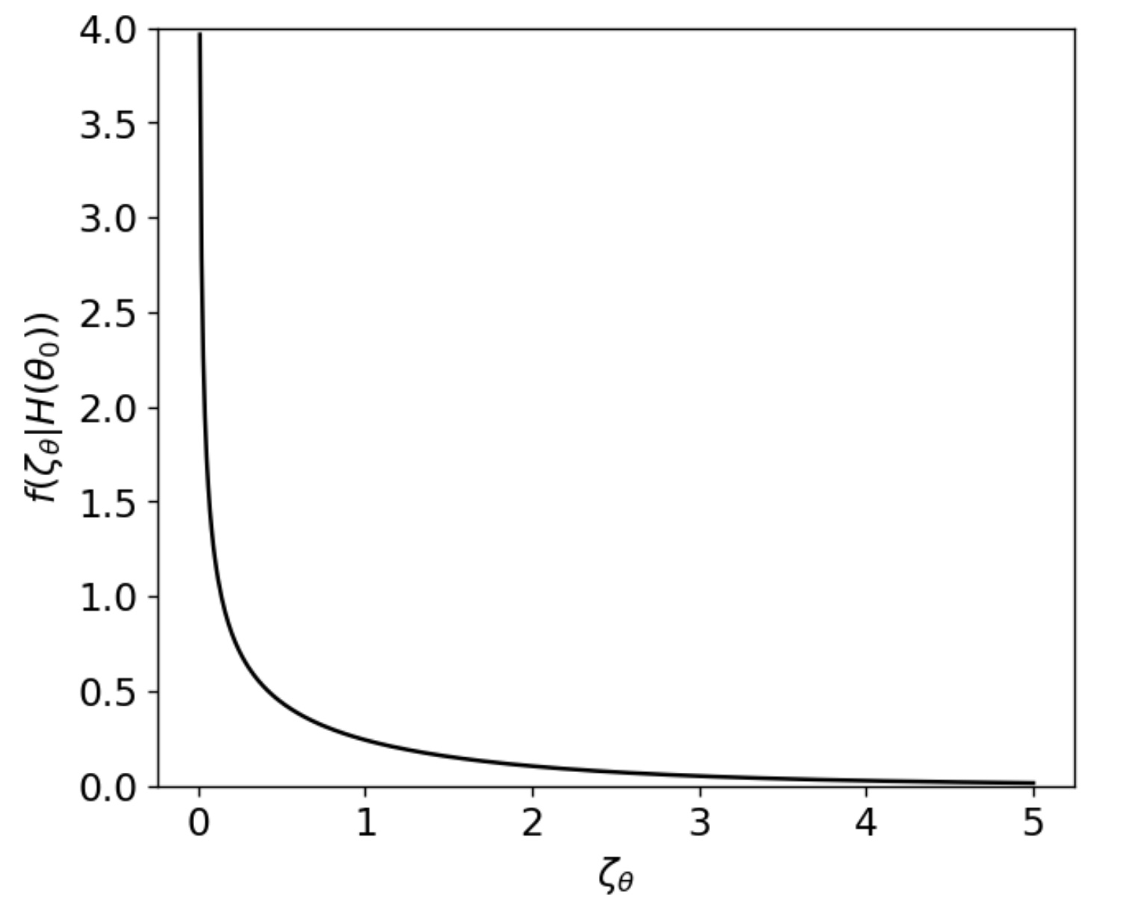
Confidence intervals
If θ = θ₀ the distribution of will be with n = the length of θ ( if 1 parameter, n=1 ) in the limit of large data sets
→ This is Wilks’ theorem, the proof of which is rather long and makes use of the Central Limit Theorem

Slide 6
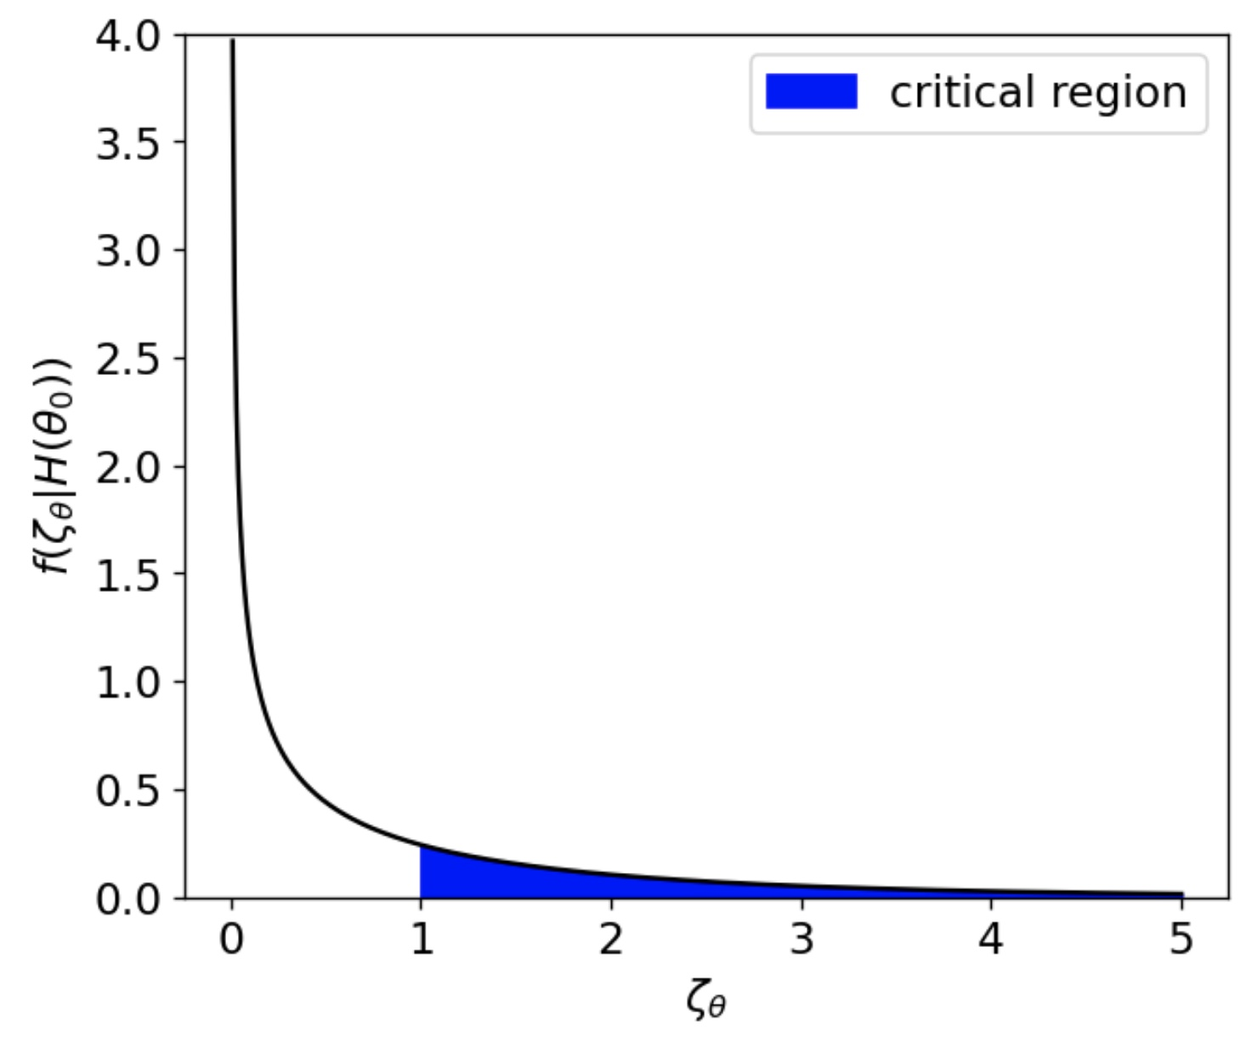
Confidence intervals
If θ = θ₀ the distribution of will be with n = the length of θ ( if 1 parameter, n=1 ) in the limit of large data sets
→ This is Wilks’ theorem, the proof of which is rather long and makes use of the Central Limit Theorem
Choose α = 0.32
Find the critical region under H₀

Slide 7
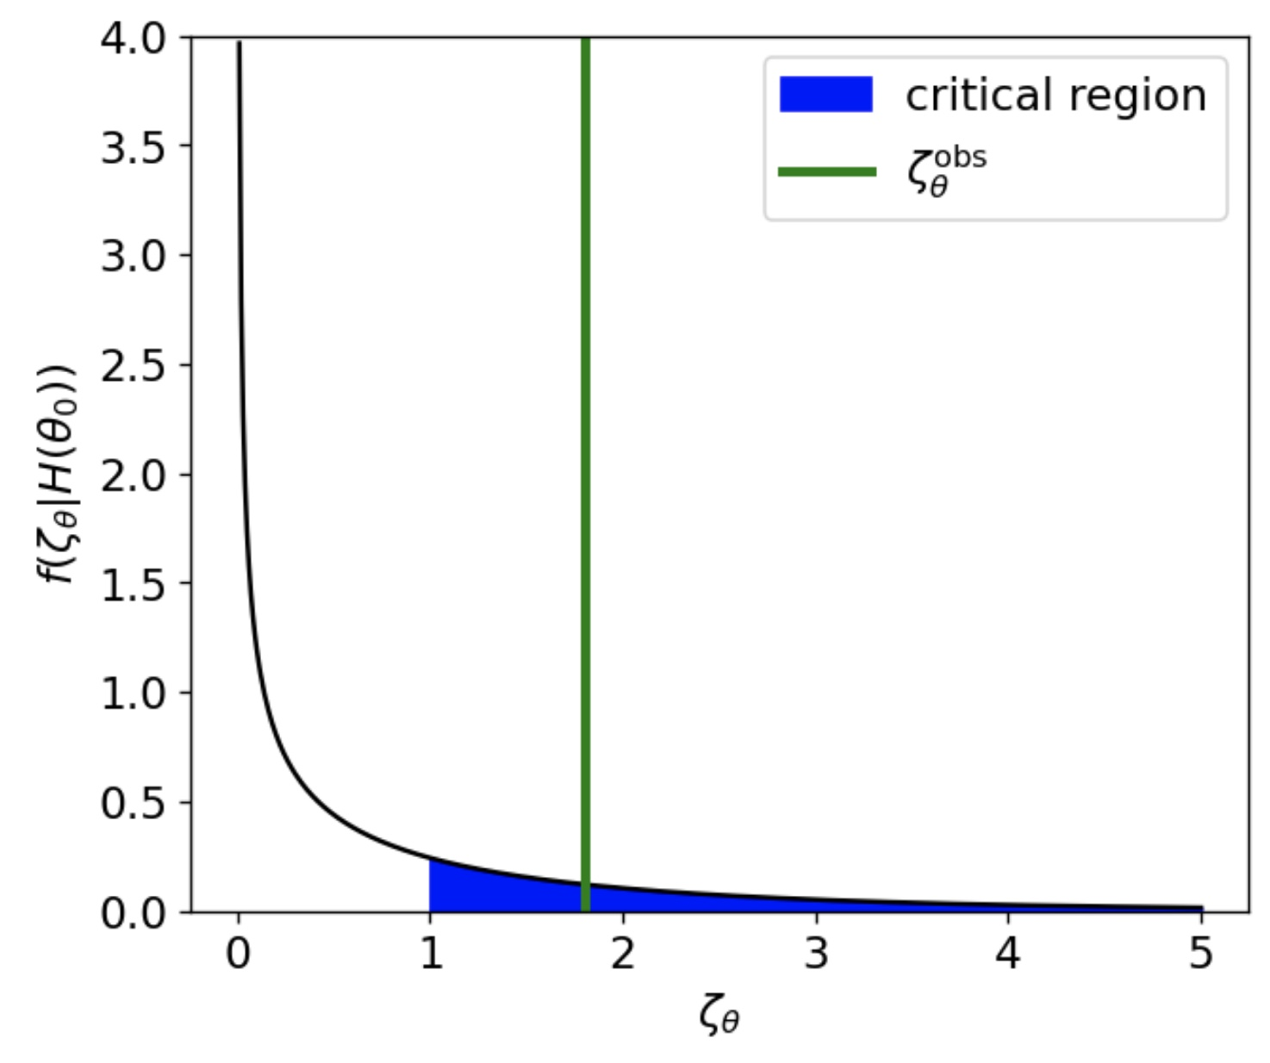
Confidence intervals
If θ = θ₀ the distribution of will be with n = the length of θ ( if 1 parameter, n=1 ) in the limit of large data sets
→ This is Wilks’ theorem, the proof of which is rather long and makes use of the Central Limit Theorem
Choose α = 0.32
Find the critical region under H₀
Calculate the value of . If inside critical region, reject H₀

Slide 8
Confidence intervals
If θ = θ₀ the distribution of will be with n = the length of θ ( if 1 parameter, n=1 ) in the limit of large data sets
→ This is Wilks’ theorem, the proof of which is rather long and makes use of the Central Limit Theorem
Choose α = 0.32
Find the critical region under H₀
Calculate the value of . If inside critical region, reject H₀
Otherwise, do not reject H₀

Slide 9
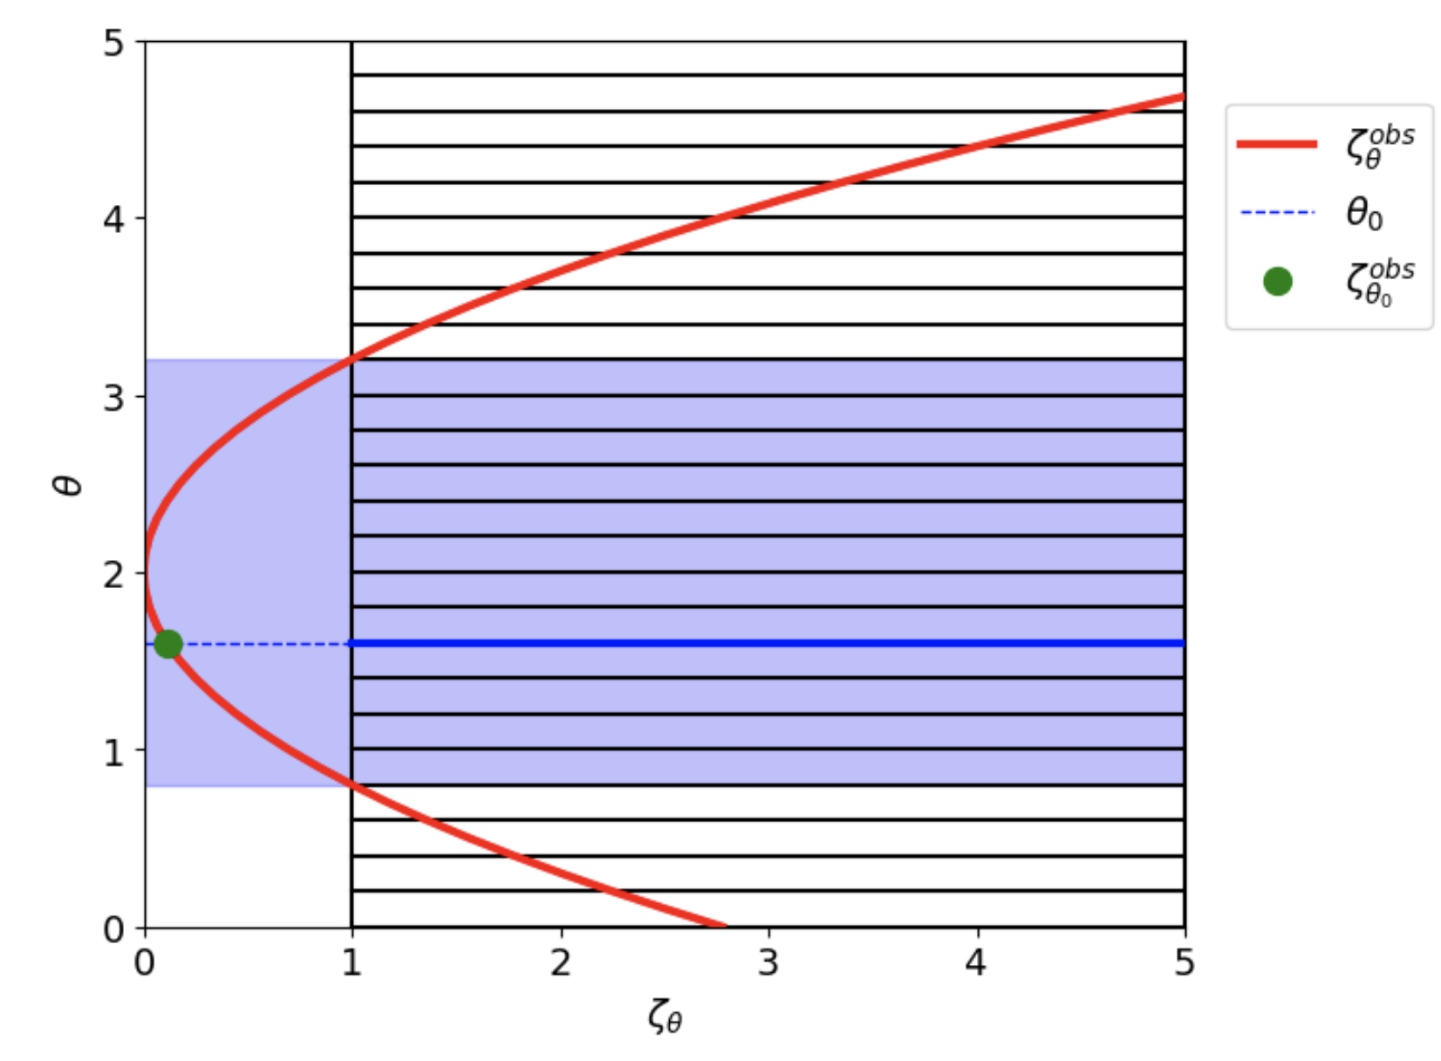
Confidence intervals
4. Repeat this procedure for different values of θ → test multiple null hypotheses
5. All of the values θ that are not rejected with α=0.32 form the 68% confidence interval!
Interactive notebook
Do you recognize this procedure from the lectures/notebooks?

Slide 10
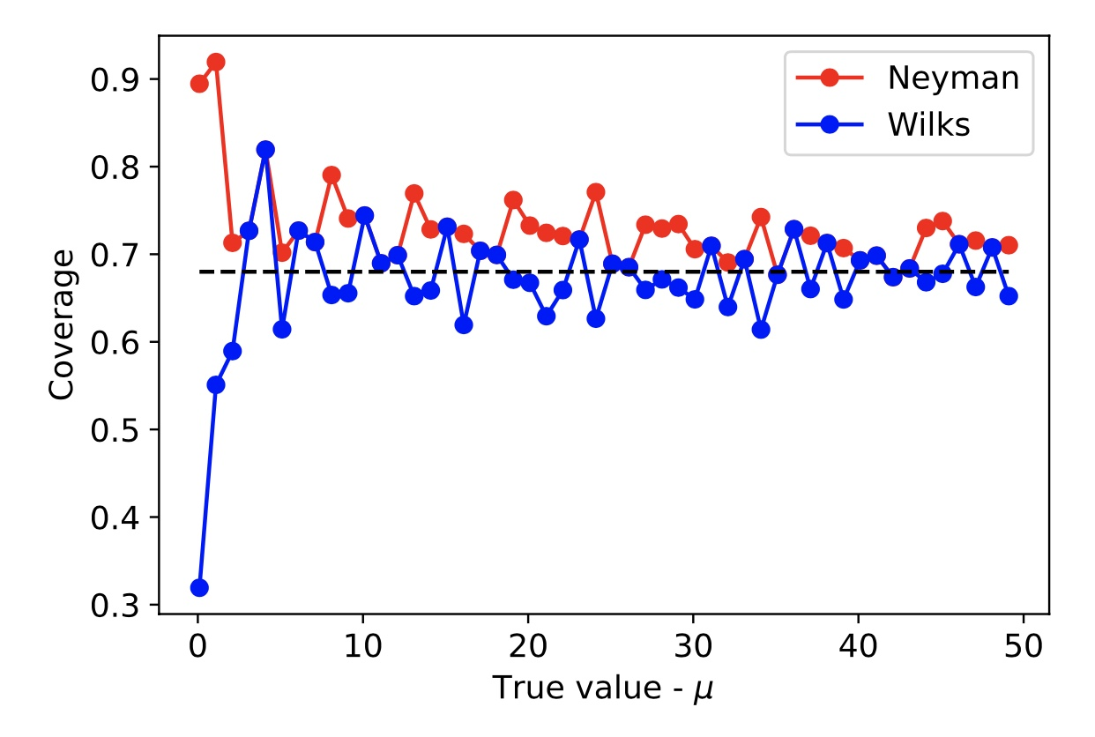
Confidence intervals
This construction doesn’t always work …
1. When the sample size is small (cannot apply Wilks’ theorem), we cannot assume the distribution
2. If we have discrete random variables, we may not be able to find critical regions that give us the desired Type-1 error rate
E.G measuring the value of λ in a Poisson process
Assuming Wilks theorem leads to under-coverage for small λ
Full calculation leads to over-coverage since k is a discrete random variable
λ

Slide 11
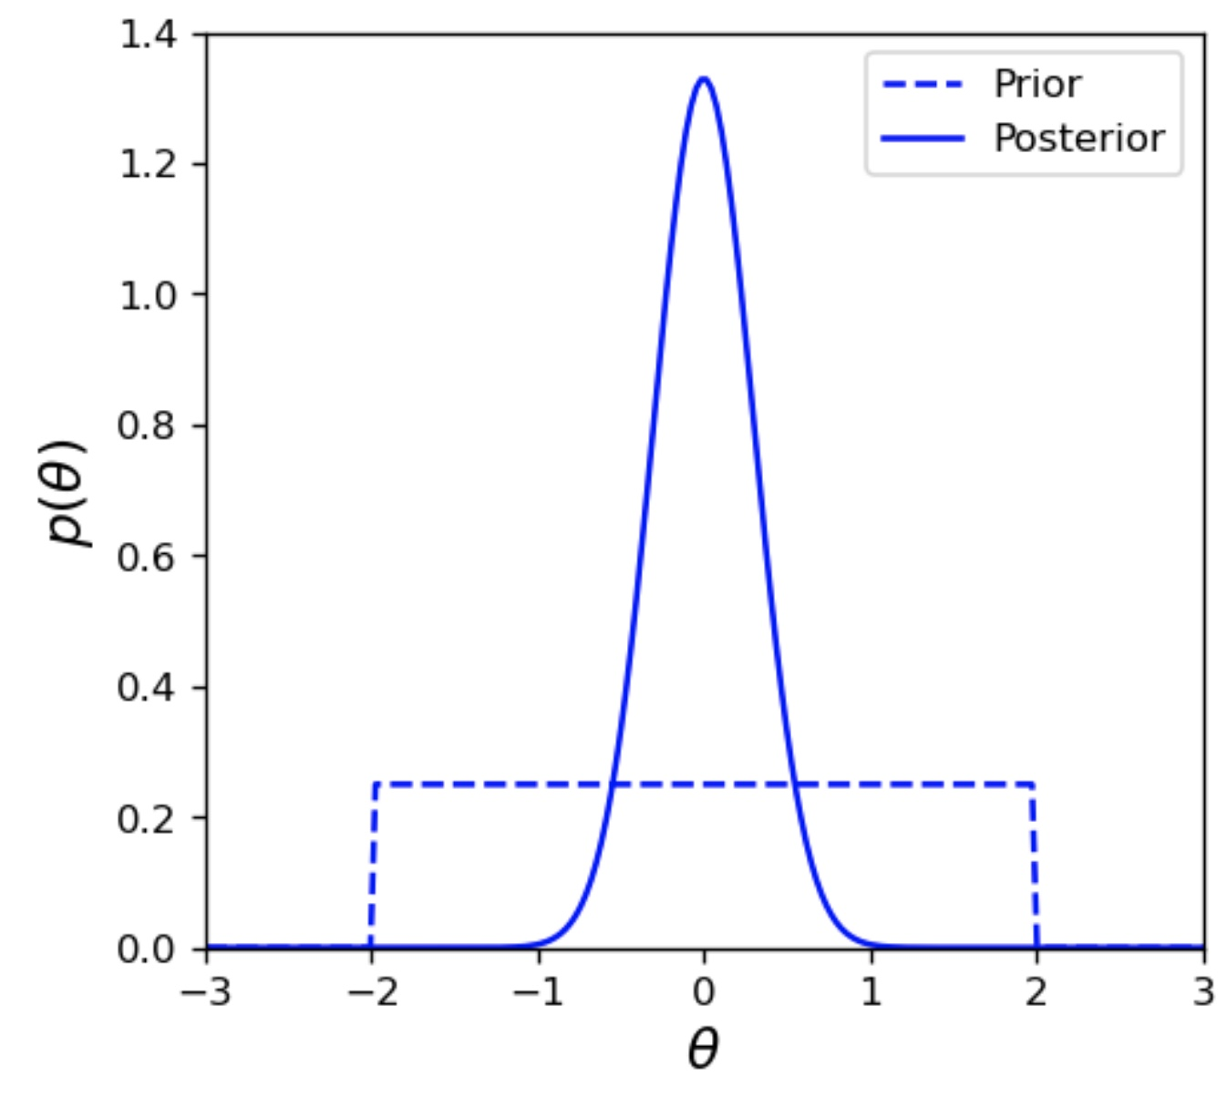
Credible Intervals
Bayesian uncertainties come directly from the posterior distribution of the parameter θ
Represents our knowledge of θ before seeing the data (prior probability)
Represents our knowledge of θ after seeing the data (posterior probability)

Slide 12
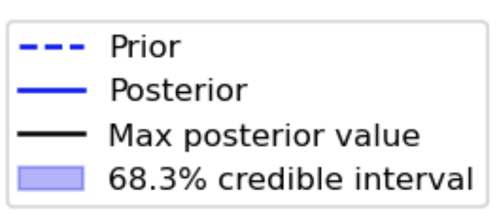
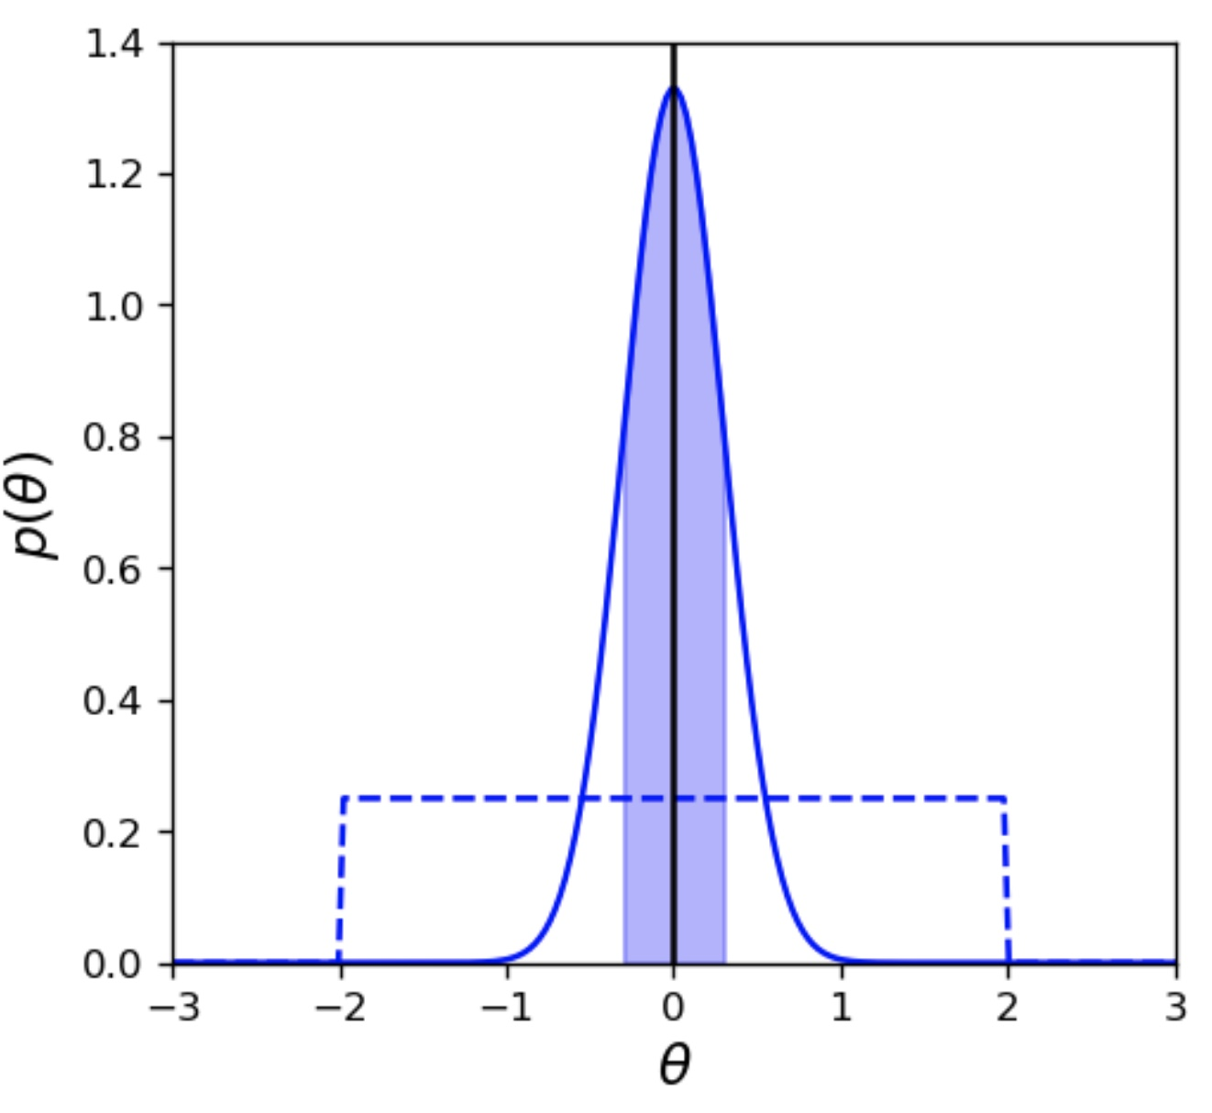
Credible Intervals
Bayesian uncertainties come directly from the posterior distribution of the parameter θ
Represents our knowledge of θ before seeing the data (prior probability)
Represents our knowledge of θ after seeing the data (posterior probability)
The parameter estimate is usually taken as the maximum posterior value (mpv)
Uncertainties are determined by the region of the posterior distribution that contains a fraction (1-α)

Slide 13
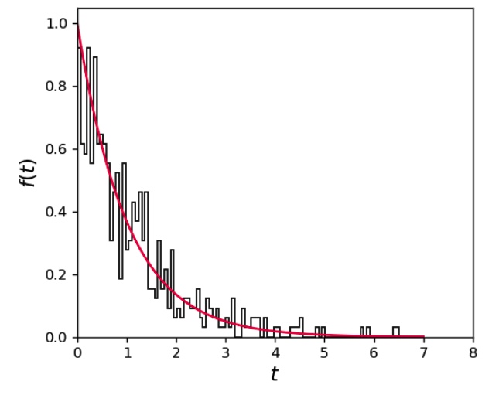
Example (exponential)
Consider an example where we want to measure the decay time of some process τ
We have 500 observations of the decay time t

Slide 14
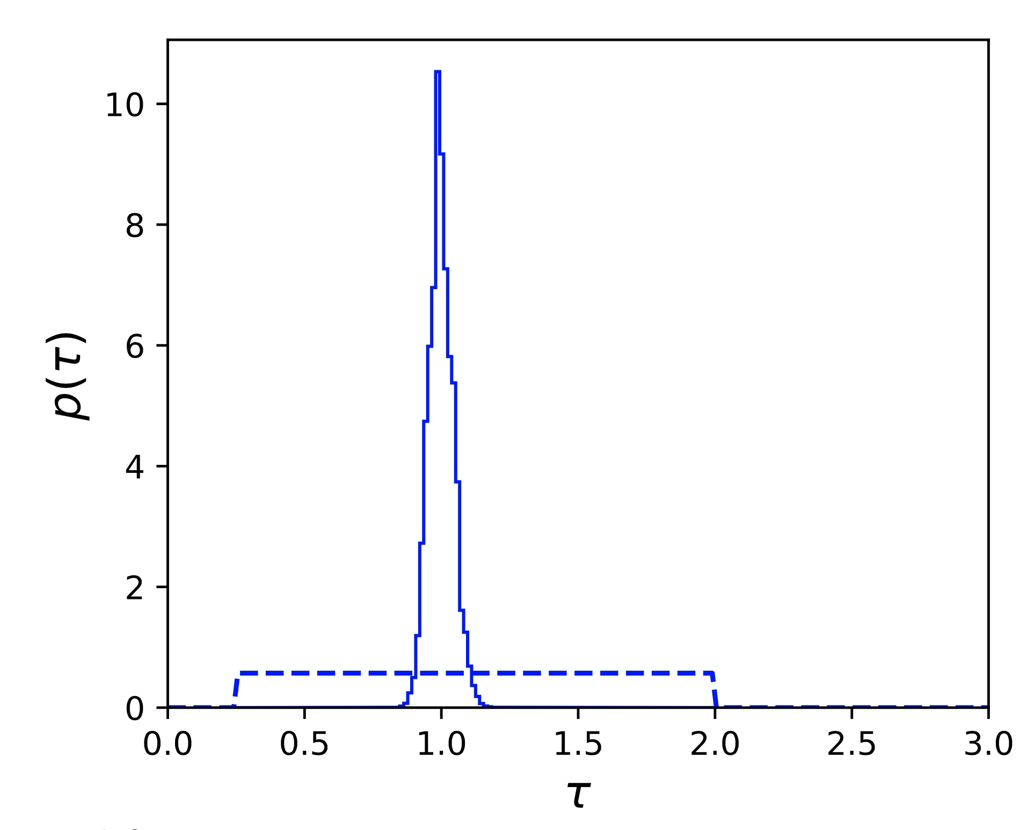
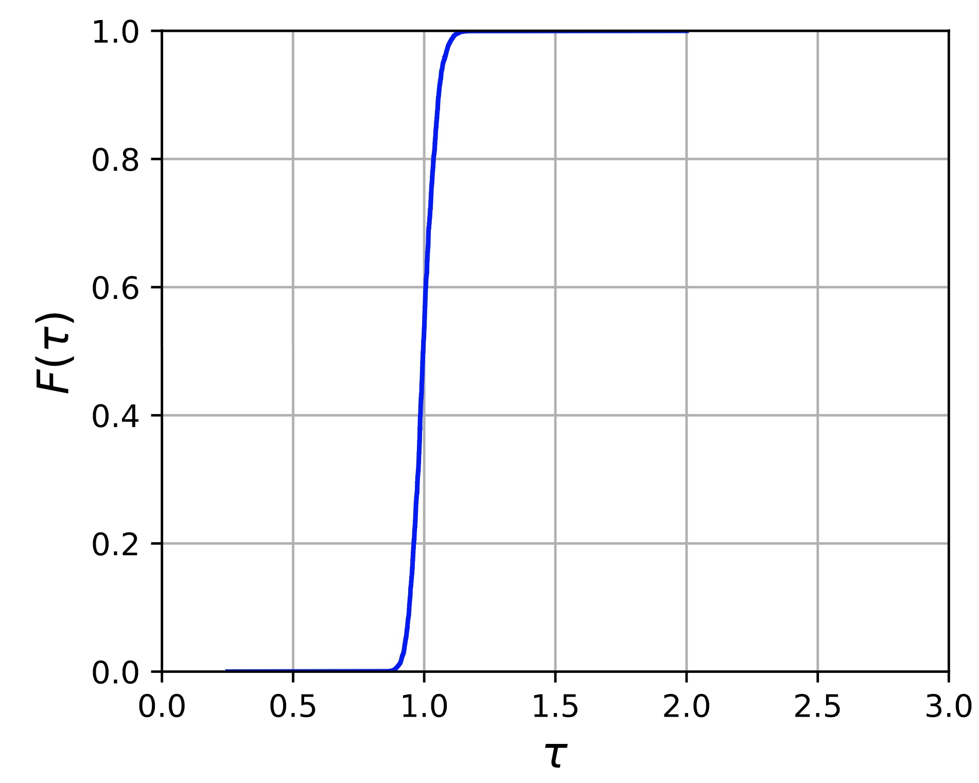
Example (exponential)
A common choice for the prior is a uniform distribution over some fixed range
One way to calculate the posterior is to generate random values (Monte Carlo) according to the prior and fill a histogram with weights given by the likelihood function
Posterior
Prior

Slide 15
Example (exponential)
We can use the quantiles of the empirical CDF of this weighted histogram to obtain the mpv, and uncertainties
Posterior
Prior

Slide 16
Example (exponential)
An equally valid parameterization of the decay process is to consider the decay rate λ instead
If the prior on τ is uniform distributed, then the prior distribution of λ will look like

Slide 17
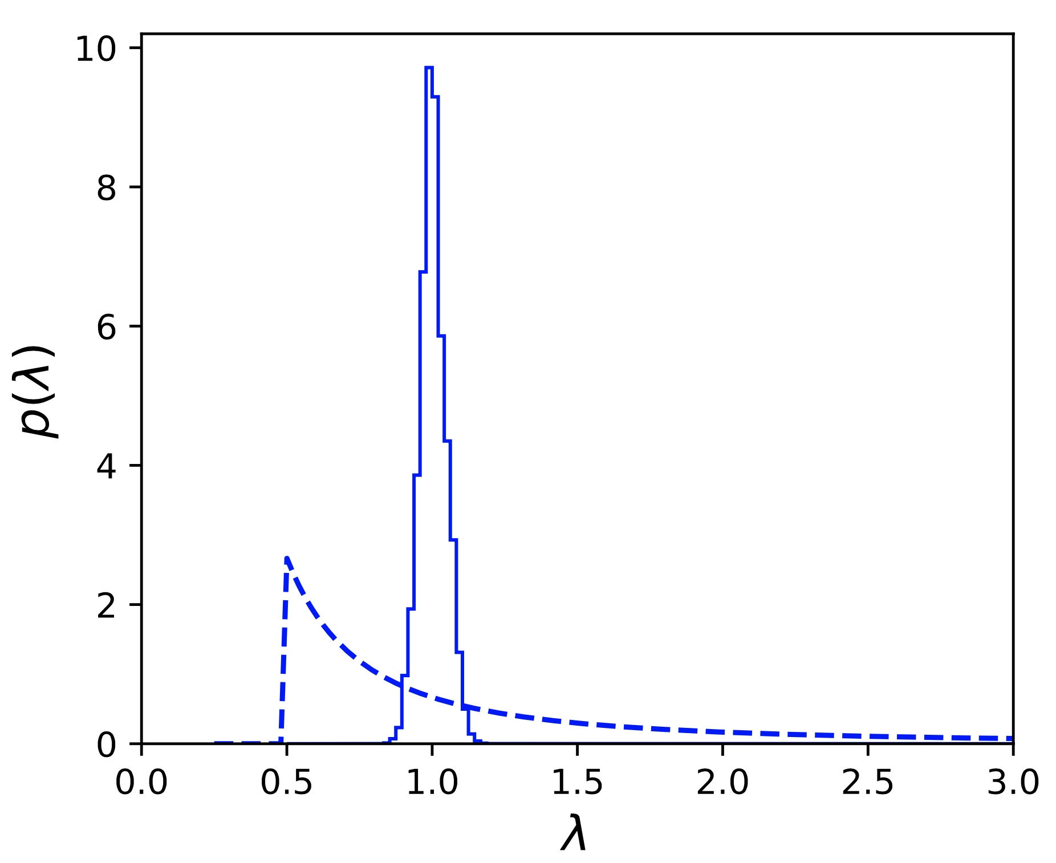
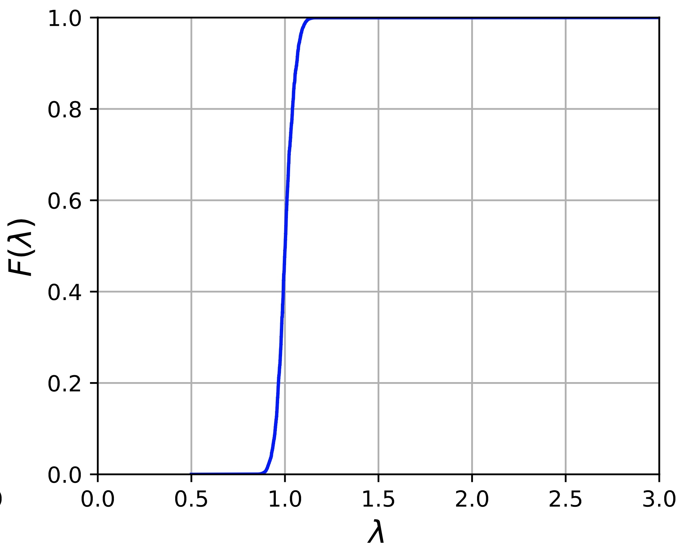
Example (exponential)
Ok, looks sensible
We also find that

Slide 18
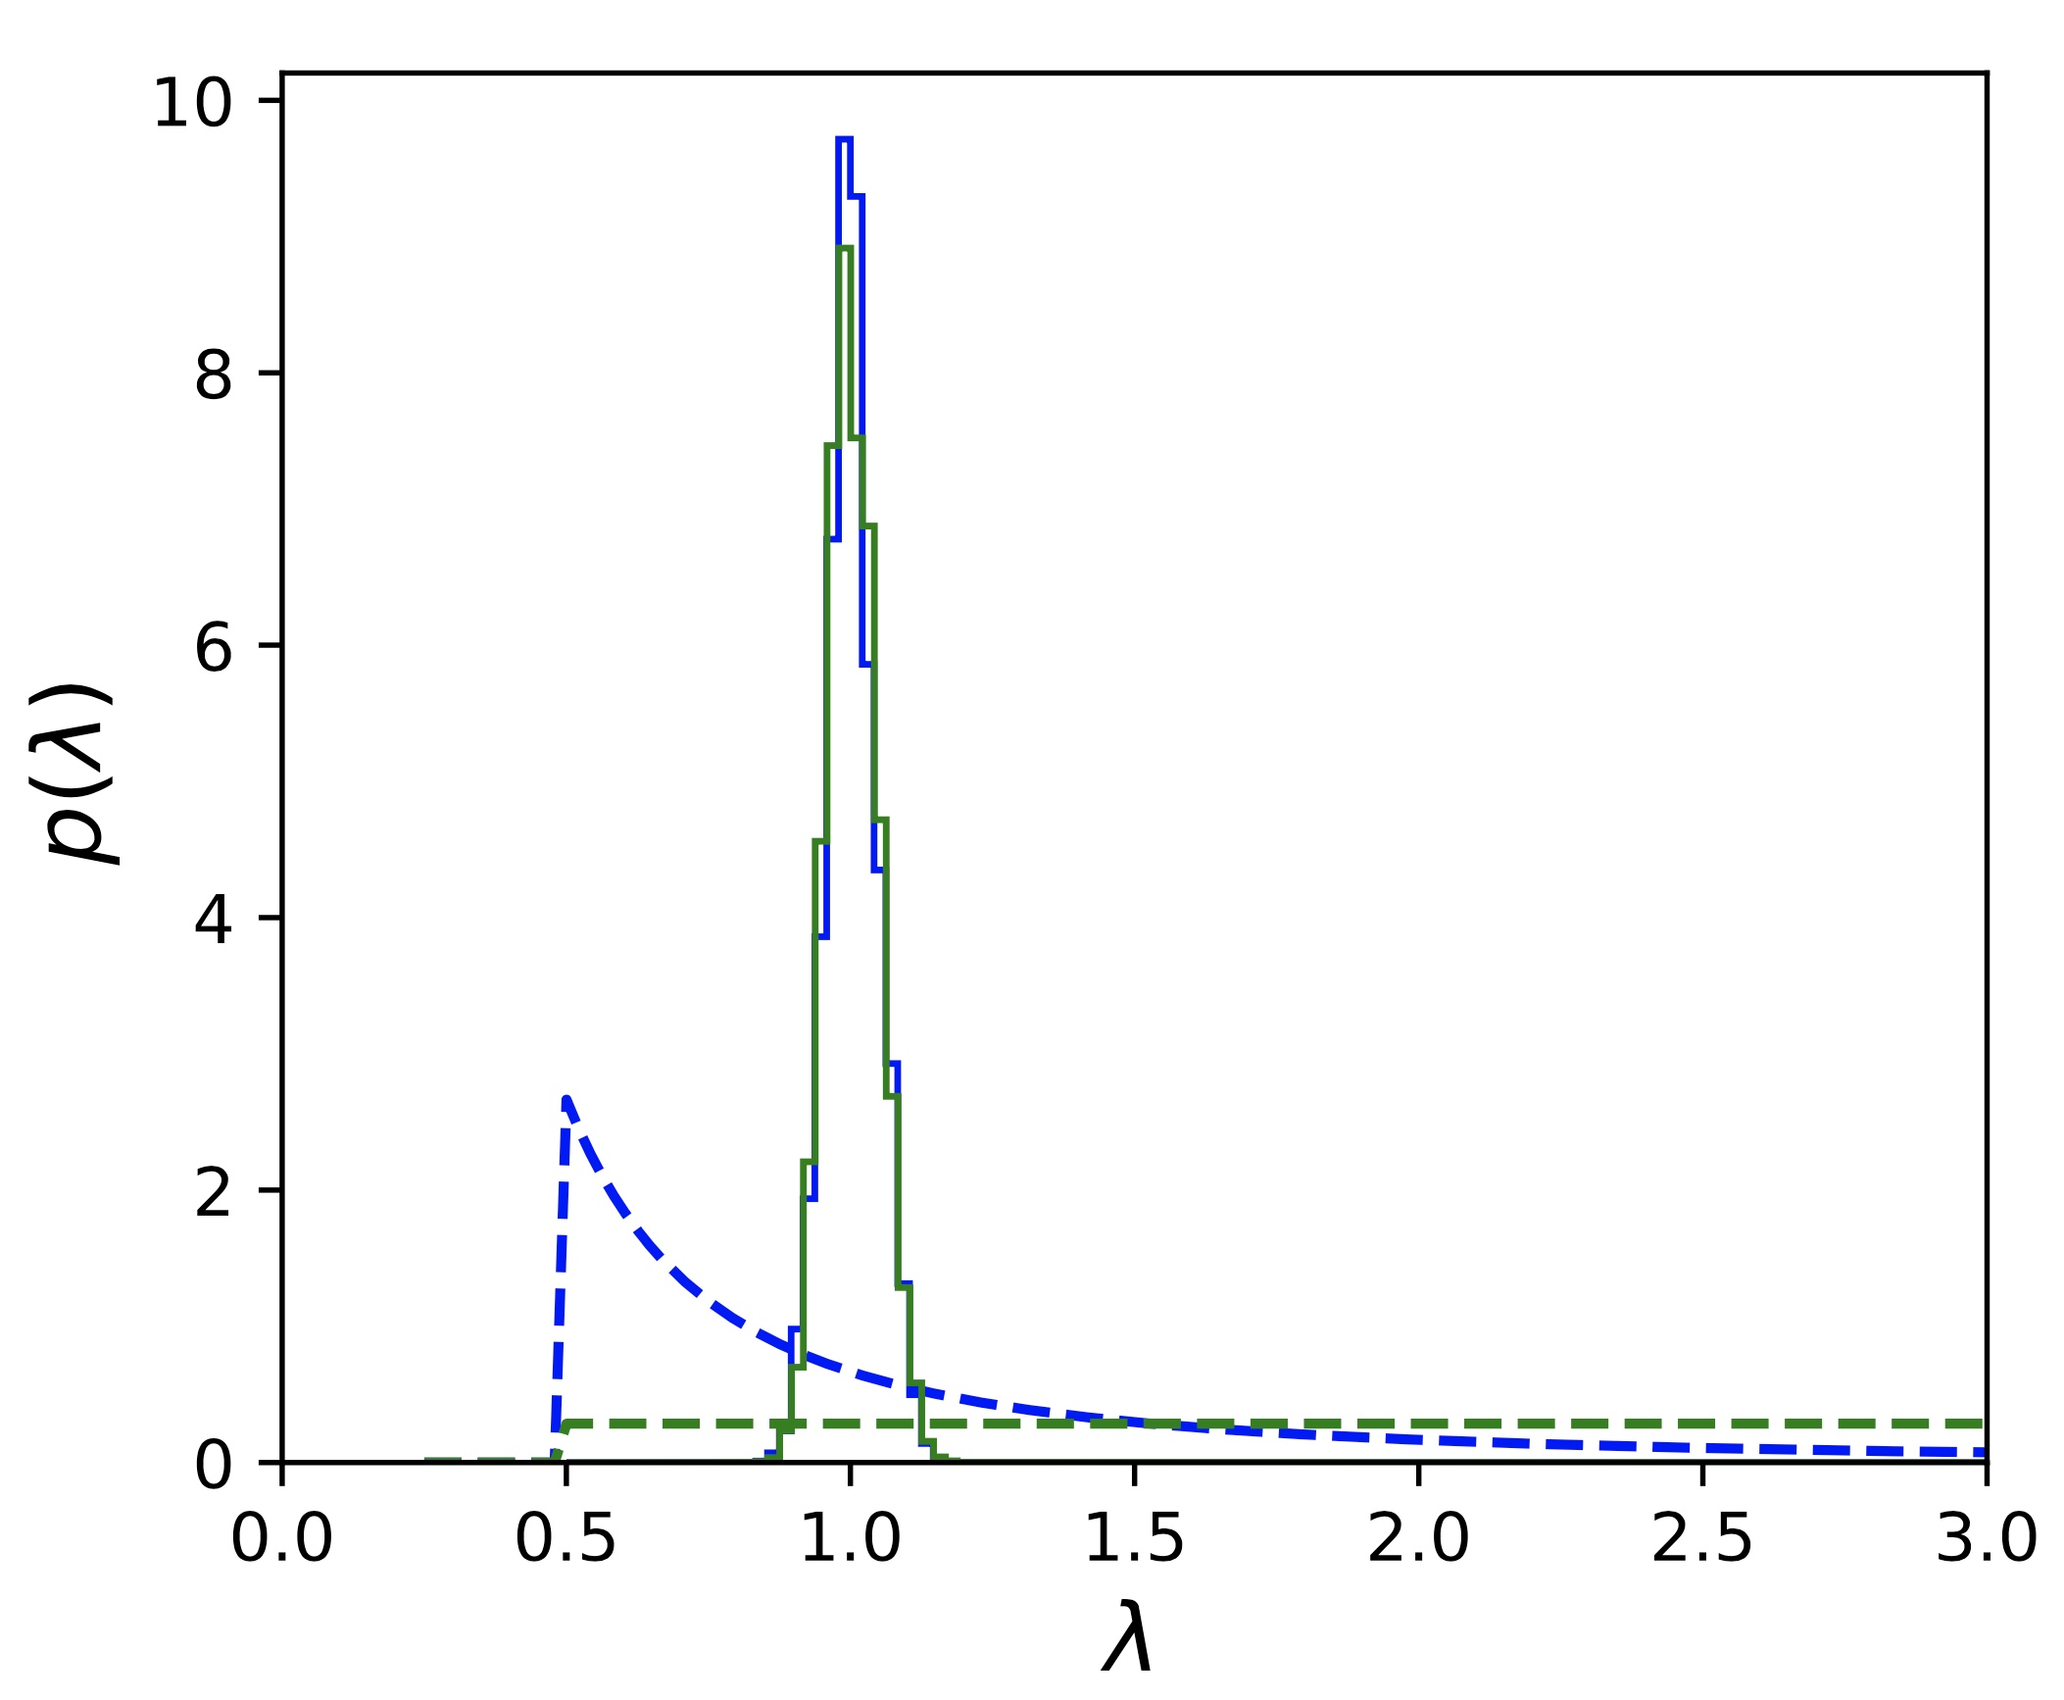
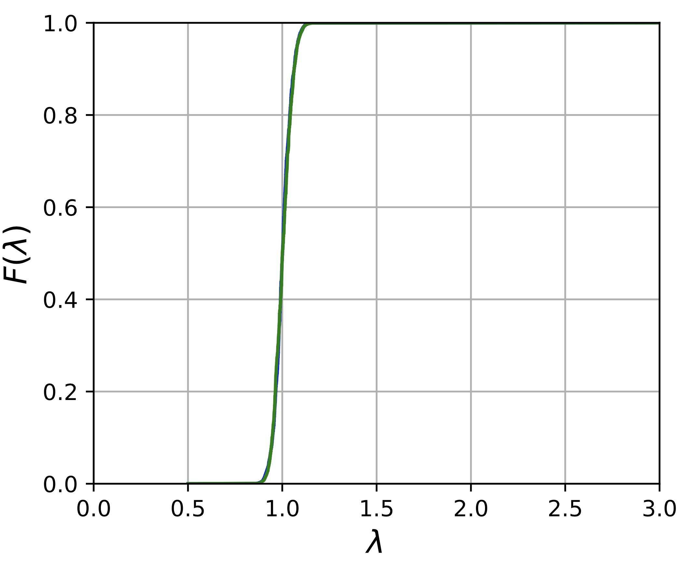
Example (exponential)
What if we instead assumed the prior for λ was uniform?
Things don’t change very much!

Slide 19
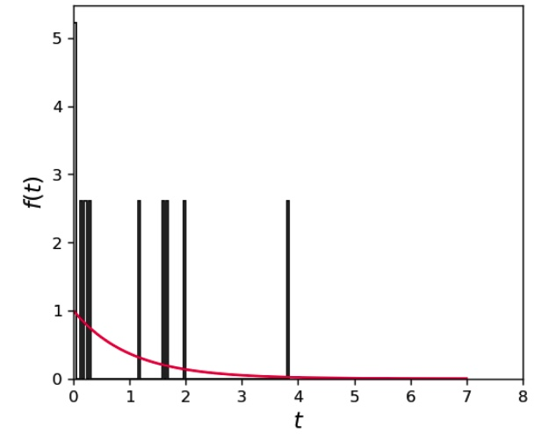
Example (exponential)
What if we had fewer events?
Say 10 events?

Slide 20
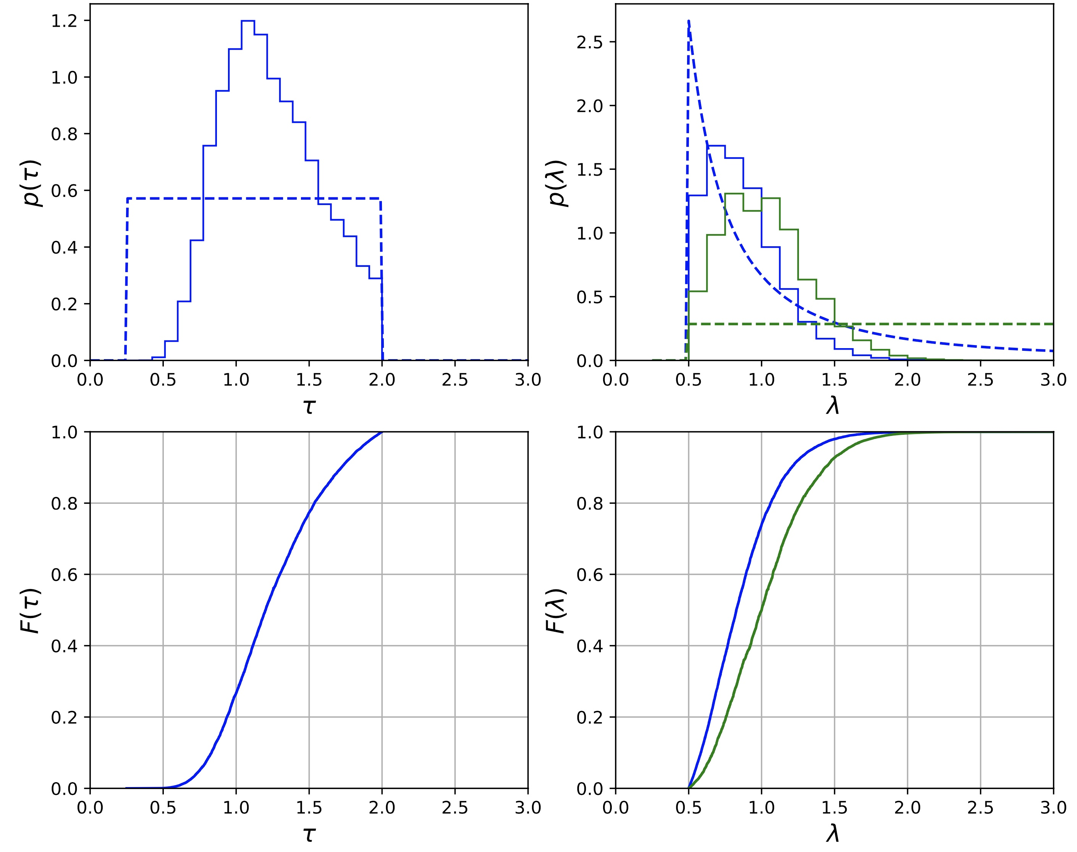
Example (exponential)
Now the choice of the prior distribution for λ matters!
We can find that
depending on what we assume about our prior knowledge!
This is something you have to be careful of when calculating Bayesian credible intervals!

Slide 21
Summary
Uncertainty of measurements is not as straightforward as we have made it seem in lectures
Frequentists calculate confidence intervals
Very closely related to hypothesis testing
Worry about coverage of intervals
Bayesians calculate credible intervals
Consistent with application of Bayes’ theorem (very natural approach)
Worry about prior assumptions on parameters of the model

Slide 22
Summary
Uncertainty of measurements is not as straightforward as we have made it seem in lectures
Frequentists calculate confidence intervals
Very closely related to hypothesis testing
Worry about coverage of intervals
Bayesians calculate credible intervals
Consistent with application of Bayes’ theorem (very natural approach)
Worry about prior assumptions on parameters of the model
I haven’t discussed how systematic uncertainties fit into these pictures (trust me, it gets even more confusing)!
In the limit of large datasets, these issues often become less relevant, but its best to be aware of them so you don’t get caught out,
How large is large? It depends ☺

